Slide 1
Rocket Telemetry Collection Presentation
By Nawras Rawas Qalaji

Slide 2
Rocket Telemetry Collection:
Objective
The Rocket Telemetry Collection project was originally used during the 2019 Battle of the Rockets Competition.
After gaining more experience in embedded engineering, the project was updated to better reflect a more professional standard of programming. The following presentation is for the new version.
The project objective is to transmit, receive and graph telemetry from a rocket during its flight
Transmit airspeed, acceleration and altitude from rocket
Receive telemetry at the ground station
Graphed the telemetry data against time
2019 Battle of the Rockets Western High School Team
Name | Role
Dylan Ogrodowski | Project Manager
Michael Wong | Design Lead
William Ogden | Technical Design
Sebastian Benedeti | Safety Officer
Juan Bustios | Logistics Manager
Anton Rajko | Recovery Specialist
Christopher Kane | Payload Integration Specialist
Nawras RQ | Payload Software Specialist

Slide 3
Rocket Telemetry Collection:
Process
The following is an overview of the electrical components used in the project
Arduino UNO:
Microcontroller used to process data
LIS3DH Accelerometer:
Reads acceleration up to ±16g or 156.9m/s^2
I2C Connection
MPL3115A2 Altitude Sensor:
Reads altitude up to 10km
I2C Connection
Pitot Tube and MS5525DSO Sensor:
Reads airspeed up to 100m/s
I2C Connection
XBee Explorer Dongle
Connects XBee receiver to laptop via USB
XBee Pro Series 1 PCB Radios:
1 mile range with up to 250kbps
UART Connection for Arduino and XBee Explorer Dongle communication
Quad AAA Battery Mount and batteries
Supplies about 14 hours of battery life to the Arduino UNO
Li-Poly Battery
Supplies about 5 hours of battery life to the Xbee transmitter
I2C communication protocol was used to limit the number of wires to fit easily within a small payload size. Pull up resistors are also built into the Arduino UNO
UART Communication was used between rocket and ground station for its full duplex, asynchronous communication

Slide 4
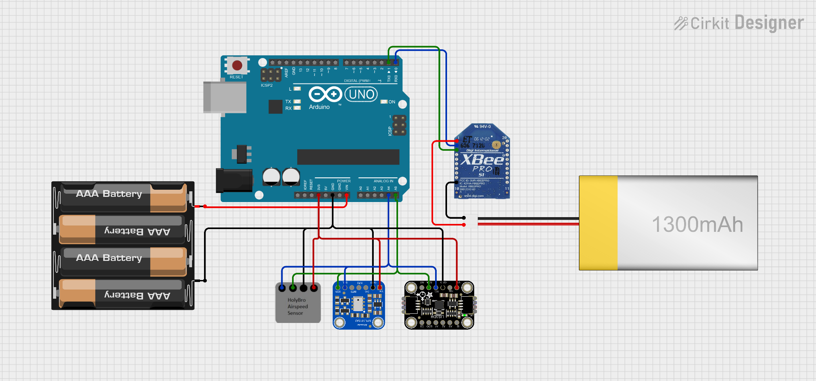
Circuit Sheet and Pinouts
AAA Battery Mount
Positive to VIN
Negative to GND
Accelerometer
VCC to 3.3V
GND to GND
SDA to A5
SCL to A4
Altimeter
VIN to 3.3V
GND to GND
SDA to A5
SCL to A4
Pitot Tube Sensor
VIN to 3.3V
GND to GND
SDA to A5
SCL to A4
LiPoly Battery
Positive to VCC
Negative to GND
XBee Radio
VCC to Positive
GND to Negative
DOUT to RX
DIN to TX

Slide 5
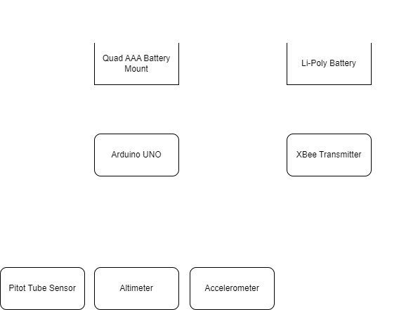
Power Supply
Two power supplies are used in order to separate the Xbee radio from other components
Xbee idling and RX current draw is 50mA
TX peaks at 250mA
Arduino UNO recommended current per pin is 20mA
Components draw 19.4mA from 3.3v pin
Quad AAA Battery Mount: 1000mAh Capacity at 6V
Arduino UNO: 50mA from 5V - 9V
Accelerometer: 6mA from 3V - 5V
Altimeter: 12mA from 2V - 3.6V
Pitot Tube: 1.4mA from 1.8V - 3.6V
Total battery life: 14.4 hours = 1000mAh / 69.4mA
LiPoly Battery: 1300mAh Capacity at 3.7V
Xbee Radio 250mAh at 3.7V
Total battery life: 5.2 hours = 1300mAh / 250mA

Slide 6
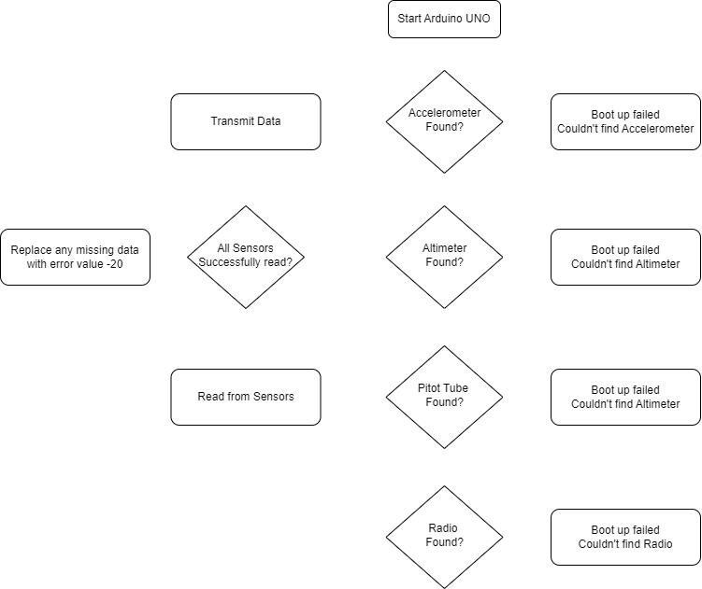
Rocket_Telemetry_Transmitter.ino
Read acceleration from LIS3DH Accelerometer
Driver: Adafruit_LIS3DH
I2C address: 0x18
Read altitude from MPL3115A2 Altimeter
Driver: Adafruit_MPL3115A2_Library
I2C address: 0x60
Read pressure and temperature from Pitot Tube
Driver: OpenVenti_MS5525DSO_by_YUBOX
I2C address: 0x76
Used with Bernoulli's principle and the ideal gas law to get airspeed
Format and transmit data using the XBee Pro every second
Digi XCTU software is used to configure radios
If a sensor wasn’t read properly, the value is replaced with a -20 custom error code
Transmit message as “sensor:value sensor:value sensor:value\n”
All messages begin with ‘P’ and end with ‘\n’

Slide 7
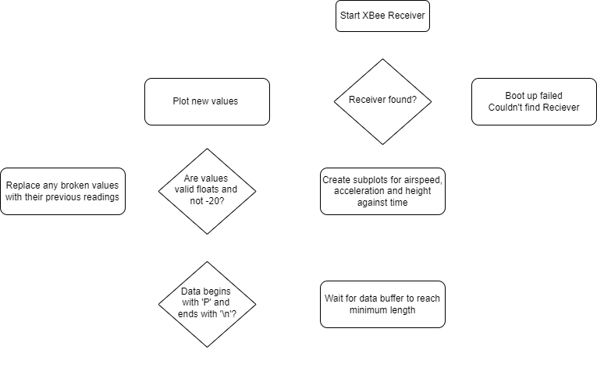
Rocket_Telemetry_Reciever.py
The ground station is made up of an XBee receiver which is connected via usb to a laptop
Initialize plots using MatplotLib
Check if receiver is connected
Create one figure and 3 subplots for airspeed, acceleration and height against time
Read data received from transmitter
Decode using utf-8
Check if data begins with ‘P’ and ends with ‘\n’
Split data using space and colon delimiter to get a list of sensor value pairs
If data is missing or equals-20, we replace it with the last known value
Plot the new points
Updates the figure with the new list of values

Slide 8
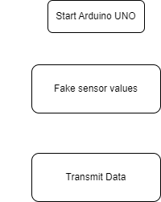
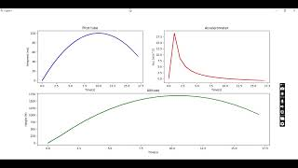
Rocket_Telemetry_Sensor_Sim.ino
In order to test the transmitter and receiver software, we can fake values and transmit them to the receiver and ground station.
Fake airspeed and altitude are based on quadratic functions for what each stage of the flight might look like
Fake acceleration is calculated based on previous airspeed - airspeed
For convenience, does not simulate actual flight time and the different rocket stages

Slide 9
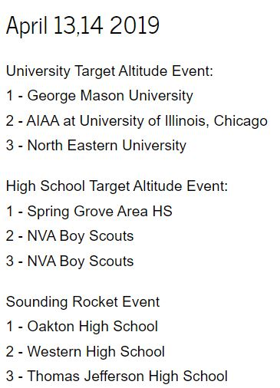
Looking Back and List of Changes
This project felt like a great one to revisit as it was one of the first projects where I experienced the entire combination of reading, transmitting, processing and visualizing real world data.
It was one of the first projects where I really felt like I was learning embedded engineering.
Rocket_Telemetry_Transmitter.ino
Cleaned and renamed Rocket_Telemetry_Transmitter.ino which was previously RocketSensorRead.ino
Changed and fixed pitot tube connections and code from GIPO to IC2
Added electronics and sensor value error checks
Rocket_Telemetry_Transmitter.py
Rewrote the Rocket_Telemetry_Reciever in python using matplotlib instead of Processing.ide
Added data and value error checks
Created a Rocket_Telemetry_Sensor_Sim for testing
Created Rocket_Telemetry_Sim.ino for better testing

